Slide 1
Heart Attack Analysis & Prediction
Presented by:
Vivek Pakalapati
Lohit Venkata Sai Nadh Polisetty
Karen Quan
Prathyusha Vattikuti

Slide 2
Abstract
Heart disease is considered as one of the major causes of death throughout the world. It cannot be easily predicted by the medical practitioners as it is a difficult task which demands expertise and higher knowledge for prediction. Here we address the issue of prediction of heart disease according to input attributes on the basis of data mining techniques.

Slide 3
Motivation for solving the problem
There are measures to prevent a heart attack from happening such as living a healthy lifestyle, having a balanced work/life schedule to reduce stress, and taking medication, however, even healthy individuals can experience a heart attack. The goal is to determine whether the individual experienced a heart attack or not based on the symptoms and tests performed. Based on the output, precautions could be undertaken which include taking medication, exercising, doing therapy to reduce stress, and eating healthier.

Slide 4
Solution methodology and evaluation metrics
Are we checking on missing values and how are we going to proceed further
Considering Decision tree and logistic regression for the dataset
Evaluation metrics: Confusion Matrix and Accuracy

Slide 5
Description of the dataset
The Heart Attack Analysis & Prediction Dataset consists of three hundred three rows and fourteen columns. This is considered a relatively small dataset which restricts how accurate our model will be.
The dependent variable is the output which determines whether the patient experienced a heart attack or not (1 or 0)
The independent variables and descriptions of each are as followed:

Slide 6
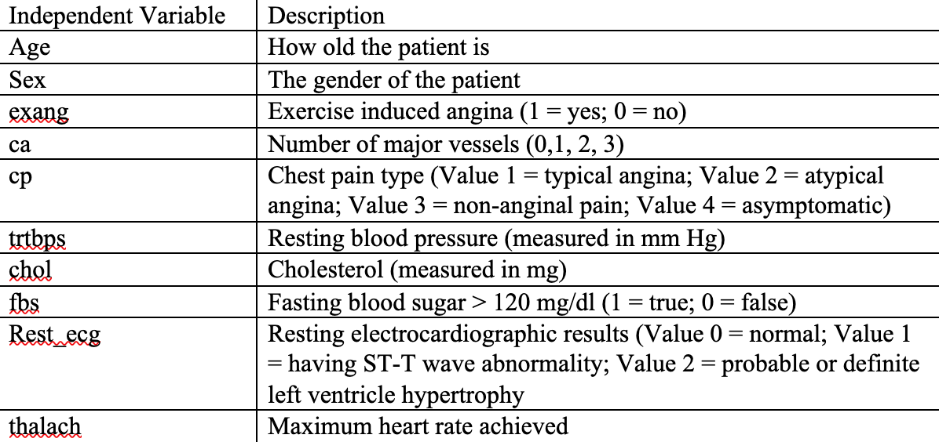
Description of the dataset

Slide 7
Comparison
There are a variety of algorithms available, including Decision Trees, Naive Bayes, Logistic Regression, K-Nearest Neighbors, and Support Vector Machine, because the data being evaluated for model development. We are comparing the accuracies of decision tree and logistic regression when developing models.
Due to their simplicity and dependability, Two-Class Boosted Decision Trees and Two-Class Logistic Regression models were chosen as the two algorithms for the analysis. When properly set, both algorithms are capable of performing well on a range of machine learning tasks, predict an outcome variable in a supervised manner

Slide 8
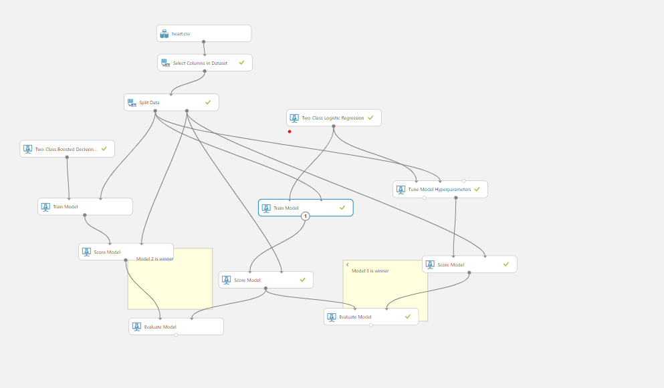

Slide 9
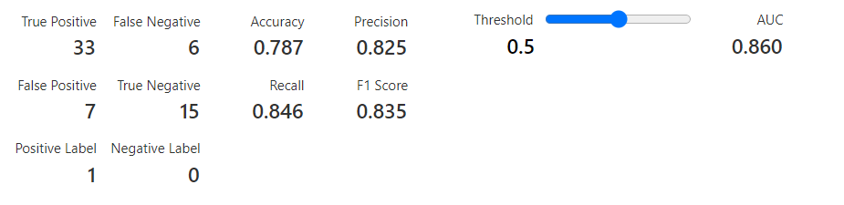
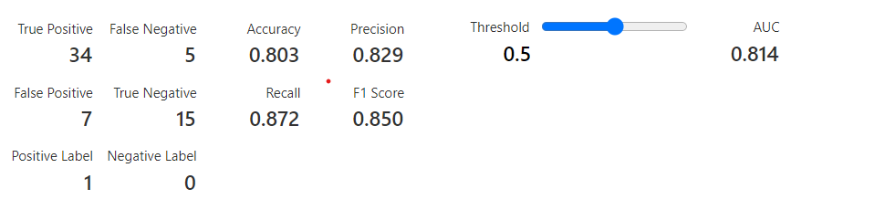
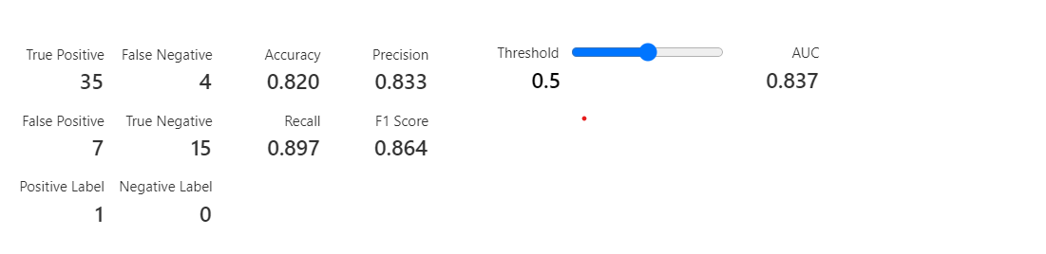

Slide 10
Summary
By applying the first approach, the accuracy achieved by the Two-Class Boosted Decision Tree is 78.3%, Logistic Regression is 80.3% and Hyper tuned Logistic Regression model is 82%. Logistic regression is having the highest accuracy here which is achieved by using the cross-validation and grid search for finding the best parameters or in other words doing the hyperparameter tuning. The Logistic regression hyper tuned model is predicting True positives as 35 and True negatives as 15. Coming to Decision tree is predicting True positives as 33 and True negatives as 15.

